Slide 1
Data Management & Information Technology
SY 2015-2016

Slide 2
Workshop Outputs
Upload duly accomplished Excel File of Masterlist of Learners for SY 2015 (Template);
Create user account for school head/principal;
Create user accounts for class advisers;
Create class and enroll learners
Next Step

Slide 3
Workshop Objectives
Explain the processes and guidelines in using the LIS-EBEIS for registering, enrolling and updating learner profiles from public schools, private schools and ALS
Capacitate participants in the operation of LIS and User Account Management System

Slide 4
Workshop Objectives
Gained understanding of the purpose, roles and processes in managing access to information systems through the User Account Management System (UAMS)
Hands-on experience in the creation and maintenance of user accounts for the different information systems

Slide 5
Workshop Legal Basis

Slide 6
Workshop Legal Basis

Slide 7
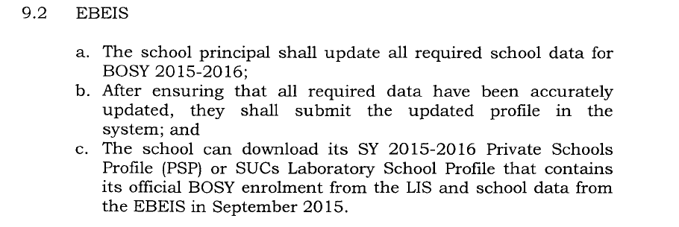
Workshop Legal Basis

Slide 8
Workshop Legal Basis

Slide 9
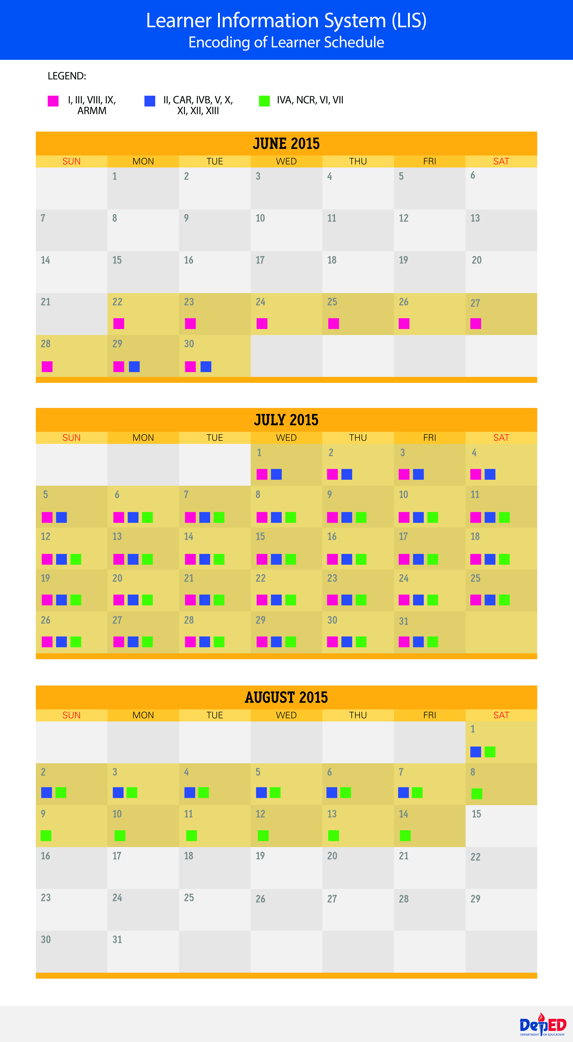

Slide 10
User Management
MATRIX OF RESPONSIBILITY

Slide 11
User Management: School Head Account
Getting Started To access the User Account Management System, type “http://lis.deped.gov.ph/uis/login” 1 at the address or location bar of a web browser, then press Enter. This will connect you to the UIS login page. Enter your username and password, then click the “Sign In” button. A successful login will direct the user to the main page that provides access to the following:
1.1. ▪ My Accounts allows the updating of a logged-in user’s own personal record, username and password.
1.2. ▪ Administration provides the facility for personnel with “Administrator” role to manage the user accounts of personnel in the office or school that his/her level of authorization is allowed. For example, a division administrator will be able to create, access and update the account of system users in his/her division. Whereas a school head and a designated school administrator will be able to create, access and update the account of system users in his/her school only. ▪ Account context displays the active office/school selected among those that the user is currently engaged with. Current role/s per office/school is also displayed when active.

Slide 12
LIS Guidelines for Operation
School Head
Monitor the progress of updating in the LIS and “finalize” the School Register for a given school year
Ensure that data on learners in the LIS and in any form of storage is kept secure and protected from any unauthorized access
Designate a secondary focal person (School ICT Coord., EBEIS Coordinator) who shall assist in providing system admin. and technical support to Class Advisers.

Slide 13
Guidelines for Operation
Class Adviser
Only nationally-funded and locally-funded teaching personnel can be assigned as Class Adviser. Volunteers cannot be assigned as CAs
The Class Adviser shall be responsible for the following:
Enroll and update the profile of all learners in his/her class in any given school year
Finalize his/her Class Register

Slide 14
Guidelines for Operation
Creation and updating of Class Adviser record
SH shall initially create a personnel record and a user account for Class Advisers in the LIS.
This personnel record is uniquely referenced by the TIN No.
After the personnel record and its corresponding user account is created, updating of personnel data can only be done by the personnel him/herself.

Slide 15
Guidelines for Operation
Creation and updating of learner profile
Class adviser shall be responsible for updating the profile of all learners in his/her class in any given school year
He/she must ensure that the learner profile is updated and supported by acceptable documents (e.g. birth certificate, etc)
The LRN uniquely references a learner in the registry.
An LRN must refer to one and only one learner
A learner must have one and only one LRN
The LRN must be attached to every learner’s school record (Form 137, etc)

Slide 16
Guidelines for Operation
Enrollment of learners
Cutoff date for reporting annual enrollment is the Friday of the week of school opening (June 5, 2015)
The deadline for the encoding of this enrollment data in the LIS is on August 2015 2nd week. Actual enrollment date shall be encoded in the system.
Late enrollees (beyond the cutoff date) will be encoded in the system even beyond the cutoff date and the deadline for encoding of annual enrollment

Slide 17
User Management: School Head Account
School Head Account: Uploading of Masterlist SY 2015
OPEN URL: http://lis.deped.gov.ph
reynashaven- havenreynas
engenius –reynashaven
Pldthomefiber - 1234567890

Slide 18
Learner information system
System Demo

Slide 19
NEXT STEP
Complete Creation of Advisers Account
Upload validated & final Masterlist of Learners in the
LIS (monitor LIS if learners’ data is incorporated)
Create Class
Set Adviser per class
Enroll Learner for SY 2015
Finalize BOSY
Download Private School Profile (ebeis)
manually fill up
Monitor EBEIS if ready for Data Entry and encode
Submit EBEIS

Slide 20
Thank You and GOD BLESS!

